Slide 1
Implementing HTTP Clients And Servers In Node.js
Monish Deshpande
22H51A05Q5

Slide 2
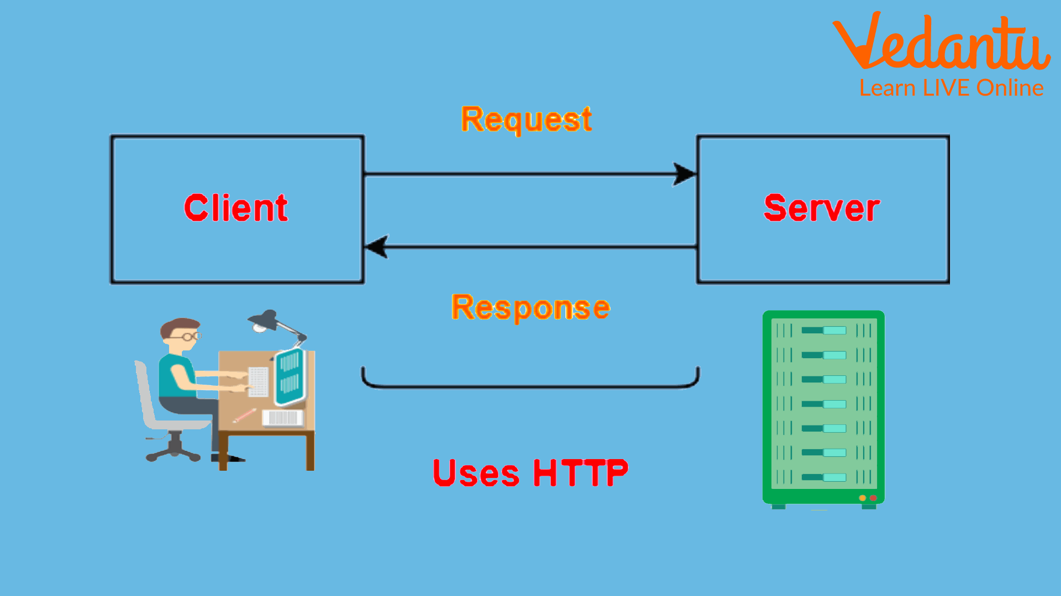
Introduction to HTTP in Node.js
The Hypertext Transfer Protocol (HTTP) is a foundational protocol for web communication.
Node.js provides built-in modules to create both HTTP clients and servers easily.
Understanding how to implement these components is crucial for building web applications.
Notes:
Image source: https://www.vrogue.co/post/hypertext-transfer-protocol-learn-definition-components-and-faqs

Slide 3

Setting Up Node.js Environment
To begin, ensure that Node.js is installed on your machine.
You can download the latest version from the official Node.js website.
After installation, verify it by running `node -v` in your command line.
Notes:
Image source: https://www.youtube.com/watch?v=WZpLJ6jLyw8

Slide 4
Creating a Basic HTTP Server
The `http` module in Node.js allows you to create a server effortlessly.
You can create a server by using the `http.createServer()` method.
This server can listen for requests on a specified port using the `server.listen()` method.
Notes:
Image source: https://medium.com/@furkandursun947/creating-a-web-server-with-node-js-using-http-module-and-logging-the-requests-76e9b60323ba

Slide 5
Handling Incoming Requests
Each incoming request can be handled using a callback function.
The callback receives two parameters: `request` and `response`.
You can parse the request and send back a response using the `response.writeHead()` and `response.end()` methods.
Notes:
Image source: https://www.researchgate.net/figure/Flow-Chart-of-processing-incoming-request_fig5_274481019

Slide 6
Creating an HTTP Client
Node.js also allows you to create HTTP clients using the `http` module.
You can use the `http.get()` method to make a simple GET request.
This method takes a URL and a callback function to handle the response.
Notes:
Image source: https://medium.com/@furkandursun947/creating-a-web-server-with-node-js-using-http-module-and-logging-the-requests-76e9b60323ba

Slide 7
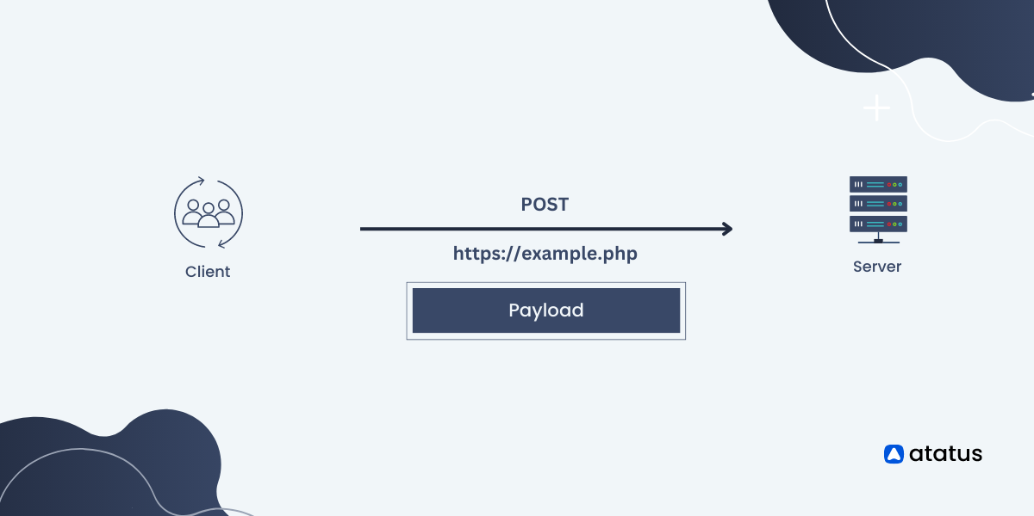
Sending Data with POST Requests
To send data to a server, you can use the `http.request()` method.
This method allows you to specify the HTTP method and set request headers.
You can write data to the request body and send it using `request.write()`.
Notes:
Image source: https://www.atatus.com/blog/http-post-request-method/

Slide 8

Error Handling in HTTP Requests
Error handling is crucial for both clients and servers in Node.js.
Use the `error` event on the server to catch and handle errors gracefully.
For HTTP clients, check the response status code to determine success or failure.
Notes:
Image source: https://www.educba.com/node-js-error-handling/

Slide 9
Using Third-Party Libraries
While Node.js provides built-in functionality, third-party libraries can simplify HTTP requests.
Libraries like Axios and Node-fetch offer a more user-friendly API.
These libraries allow for promises and async/await syntax, making code cleaner.
Notes:
Image source: https://javascript.plainenglish.io/8-extremely-handy-node-js-libraries-to-enhance-app-functionality-fdece6b8d545

Slide 10
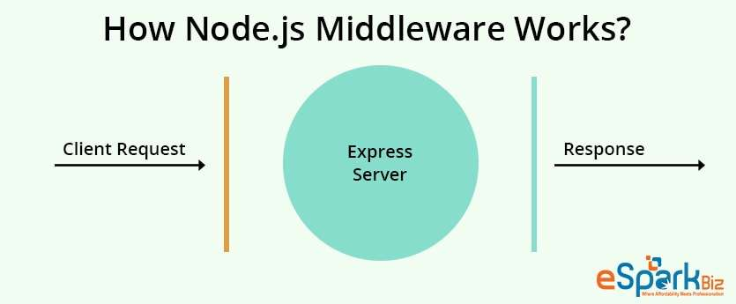
Middleware and Routing
Middleware in Node.js can manage requests more effectively in server applications.
Frameworks like Express.js provide routing capabilities to handle different endpoints.
Using middleware, you can implement features such as authentication and logging.
Notes:
Image source: https://www.esparkinfo.com/blog/how-to-create-middleware-in-node-js-and-express-js.html

Slide 11

Best Practices and Conclusion
Always validate and sanitize incoming data to prevent security vulnerabilities.
Use environment variables to manage sensitive information like API keys.
Following best practices will help ensure your HTTP clients and servers are robust and secure.
Feel free to modify any of the slides to better fit your presentation style or requirements!
Notes:
Image source: https://rapidapi.com/comics/api-security-best-practices

